Slide 1
CMP202 Assessment
By Fraser Barker(1600196)

Slide 2
Topic
Interactive Mandelbrot
Parallelised using GPU
Lab exercise used as a basis
External Libraries
OpenGL (Year 2, Semester 1 base project file)

Slide 3
Purpose
Interactive Mandelbrot via OpenGL
Demonstrate good GPU parallelisable algorithm.
What was the problem?

Slide 4
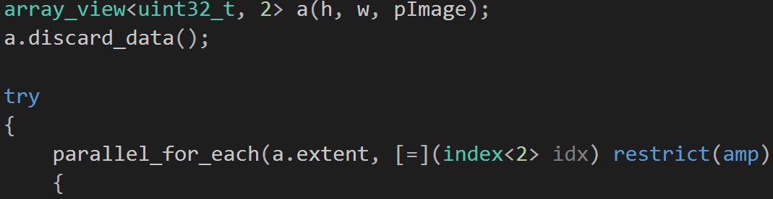
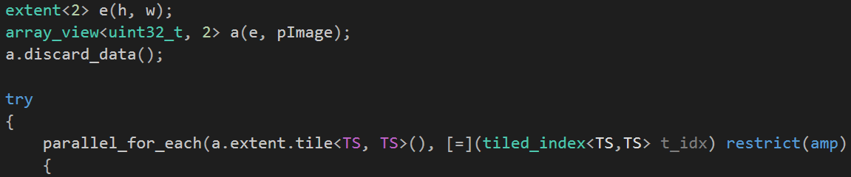
Parallel construction
Pipeline pattern
Single CPU Thread (Host)
SIMD
OpenGL calls
Mutexes?

Slide 5
Thread utilisation
Single CPU Thread (Host)
Non-tiled GPU kernel vs Tiled GPU kernel
Mandelbrot – Data independent
Multi GPU (future)

Slide 6
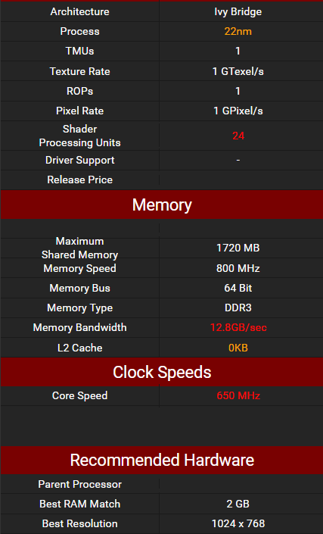
Specification
4506 Lab Computers
OS – Windows 7 Professional
GPU – Intel® HD Graphics 2500
CPU – Intel® Core™ i5-3470S @ 2.90GHz
RAM – 4GB

Slide 7
Results
Time taken to compute Mandelbrot at various levels. (Iterations, Width/Height) (ms)
1000 x (500,2500,5000 Max_Iters) @ 640x480
1000 x (500,2500,5000 Max_Iters) @ 960x768
1000 x (500,2500,5000 Max_Iters) @ 1280x960
1000 x (500,2500,5000 Max_Iters) @ 1920x1280
Eliminate sources of error

Slide 8
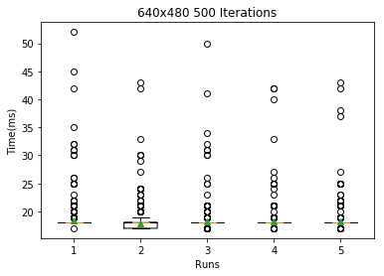
Results – 640x480 – 500 Iterations
Tile Size | Mean(ms) | Median(ms)
Not tiled | 18.4105894106 | 18.0
4 | 17.8291708292 | 18.0
8 | 18.1508491508 | 18.0
16 | 18.2137862138 | 18.0
32 | 18.2157842158 | 18.0

Slide 9
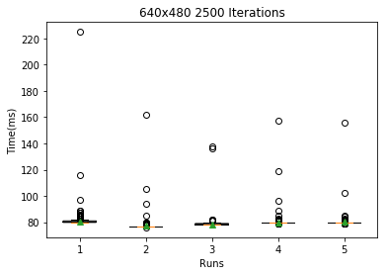
Results – 640x480 – 2500 ITERATIONS
Tile Size | Mean(ms) | Median(ms)
Not tiled | 80.6573426573 | 80.0
4 | 77.2767232767 | 77.0
8 | 78.4095904096 | 78.0
16 | 80.0799200799 | 80.0
32 | 80.1378621379 | 80.0

Slide 10
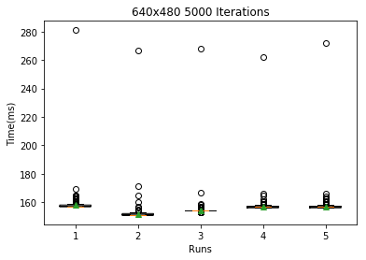
Results – 640x480 – 5000 ITERATIONS
Tile Size | Mean(ms) | Median(ms)
Not tiled | 157.963036963 | 157.0
4 | 151.51048951 | 151.0
8 | 154.268731269 | 154.0
16 | 156.754245754 | 157.0
32 | 156.92007992 | 157.0

Slide 11
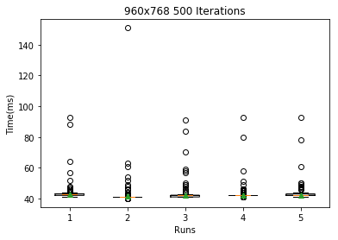
Results – 960x768 – 500 ITERATIONS
Tile Size | Mean | Median
Not tiled | 42.6983016983 | 43.0
4 | 41.4445554446 | 41.0
8 | 41.9380619381 | 42.0
16 | 42.2747252747 | 42.0
32 | 42.4185814186 | 42.0

Slide 12
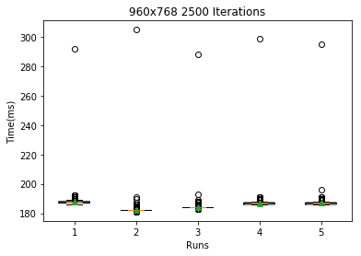
Results – 960x768 – 2500 ITERATIONS
Tile Size | Mean | Median
Not tiled | 187.566433566 | 187.0
4 | 182.123876124 | 182.0
8 | 184.236763237 | 184.0
16 | 186.776223776 | 187.0
32 | 186.97002997 | 187.0

Slide 13
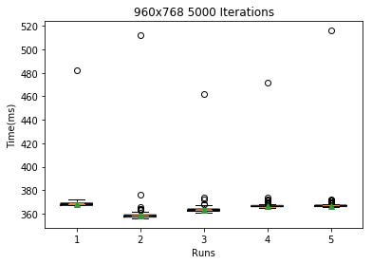
Results – 960x768 – 5000 ITERATIONS
Tile Size | Mean(ms) | Median(ms)
Not tiled | 368.331668332 | 368.0
4 | 358.282717283 | 358.0
8 | 362.982017982 | 363.0
16 | 366.833166833 | 366.0
32 | 366.839160839 | 367.0

Slide 14
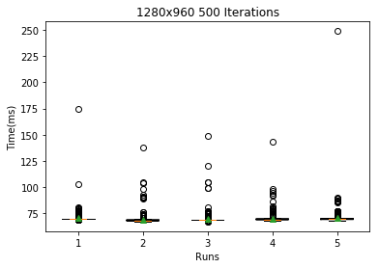
Results – 1280x960 – 500 ITERATIONS
Tile Size | Mean(ms) | Median(ms)
Not tiled | 70.2417582418 | 70.0
4 | 68.8521478521 | 68.0
8 | 69.4185814186 | 69.0
16 | 69.8181818182 | 69.0
32 | 70.2057942058 | 70.0

Slide 15
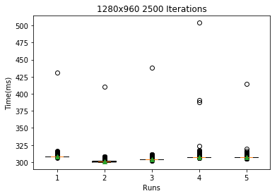
Results – 1280x960 – 2500 ITERATIONS
Tile Size | Mean(ms) | Median(ms)
Not tiled | 308.418581419 | 308.0
4 | 301.057942058 | 301.0
8 | 304.186813187 | 304.0
16 | 307.411588412 | 307.0
32 | 307.253746254 | 307.0

Slide 16
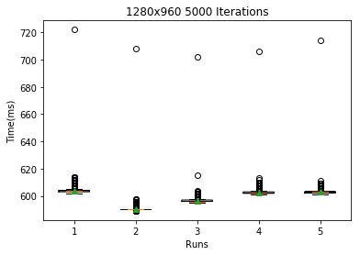
Results – 1280x960 – 5000 ITERATIONS
Tile Size | Mean(ms) | Median(ms)
Not tiled | 603.978021978 | 604.0
4 | 590.294705295 | 590.0
8 | 596.665334665 | 596.0
16 | 602.69030969 | 602.0
32 | 602.886113886 | 603.0

Slide 17
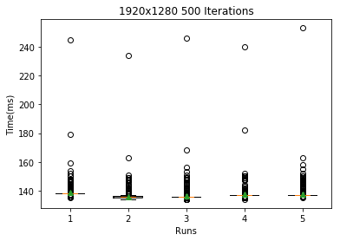
Results – 1920x1280 – 500 ITERATIONS
Tile Size | Mean(ms) | Median(ms)
Not tiled | 138.552447552 | 138.0
4 | 136.03996004 | 136.0
8 | 136.529470529 | 136.0
16 | 137.585414585 | 137.0
32 | 137.517482517 | 137.0

Slide 18
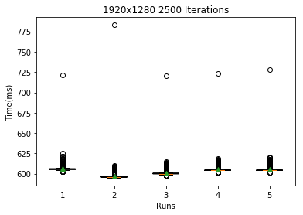
Results – 1920x1280 – 2500 ITERATIONS
Tile Size | Mean(ms) | Median(ms)
Not tiled | 606.14985015 | 606.0
4 | 596.944055944 | 596.0
8 | 600.948051948 | 600.0
16 | 605.020979021 | 604.0
32 | 604.929070929 | 604.0

Slide 19
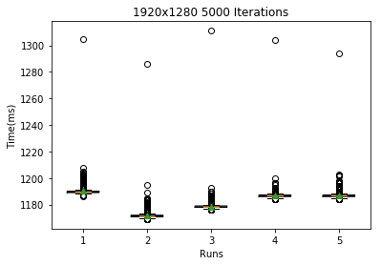
Results – 1920x1280 – 5000 ITERATIONS
Tile Size | Mean(ms) | Median(ms)
Not tiled | 1190.27072927 | 1190.0
4 | 1171.91808192 | 1171.0
8 | 1178.58941059 | 1178.0
16 | 1187.05394605 | 1187.0
32 | 1187.07992008 | 1187.0

Slide 20
Explanation
Tiled vs Non-Tiled
Shared Memory
Implicit Synchronisation
Key Result: TS 4 Best

Slide 21
Critical evaluation
Tiled vs Non-Tiled
Multi GPU

Slide 22
Technical choices
Array vs Vector
No tile-static
No barriers, Mutexes or atomic variables

Slide 23
Resources
Spyder(numpy, scipy, matplotlib) – Statistics calculations, graphical representations.
Adam Sampson/Ruth Falconer – Lab project which this submission is based off of.
Paul Robertson – OpenGL base project

Slide 24
Questions?

